Slide 1

Information Retrieval and PHP (Part 2)
KF4009 Web Technologies
2018/19

Slide 2
In this lecture
Brief recap
Connecting to a database in PHP
MySQLi
Retrieving data: Key steps
Create connection to the server
Check connection to the server
Construct and execute the query
Iterate over the results
Include

Slide 3
Recap: Client-server model
Request
Client
Server
Response

Slide 4
Recap: PHP is used to communicate with the DB
PHP and the Database reside and operate on the server side
PHP scripts interact with the database and generate HTML
Request
Server
PHP
DB (e.g. MySQL)
Response

Slide 5
Recap: We use SQL to interact with a db
SELECT … FROM … WHERE … ;
INSERT INTO … VALUES … ;
UPDATE … SET … WHERE … ;
DELETE … FROM … WHERE … ;

Slide 6
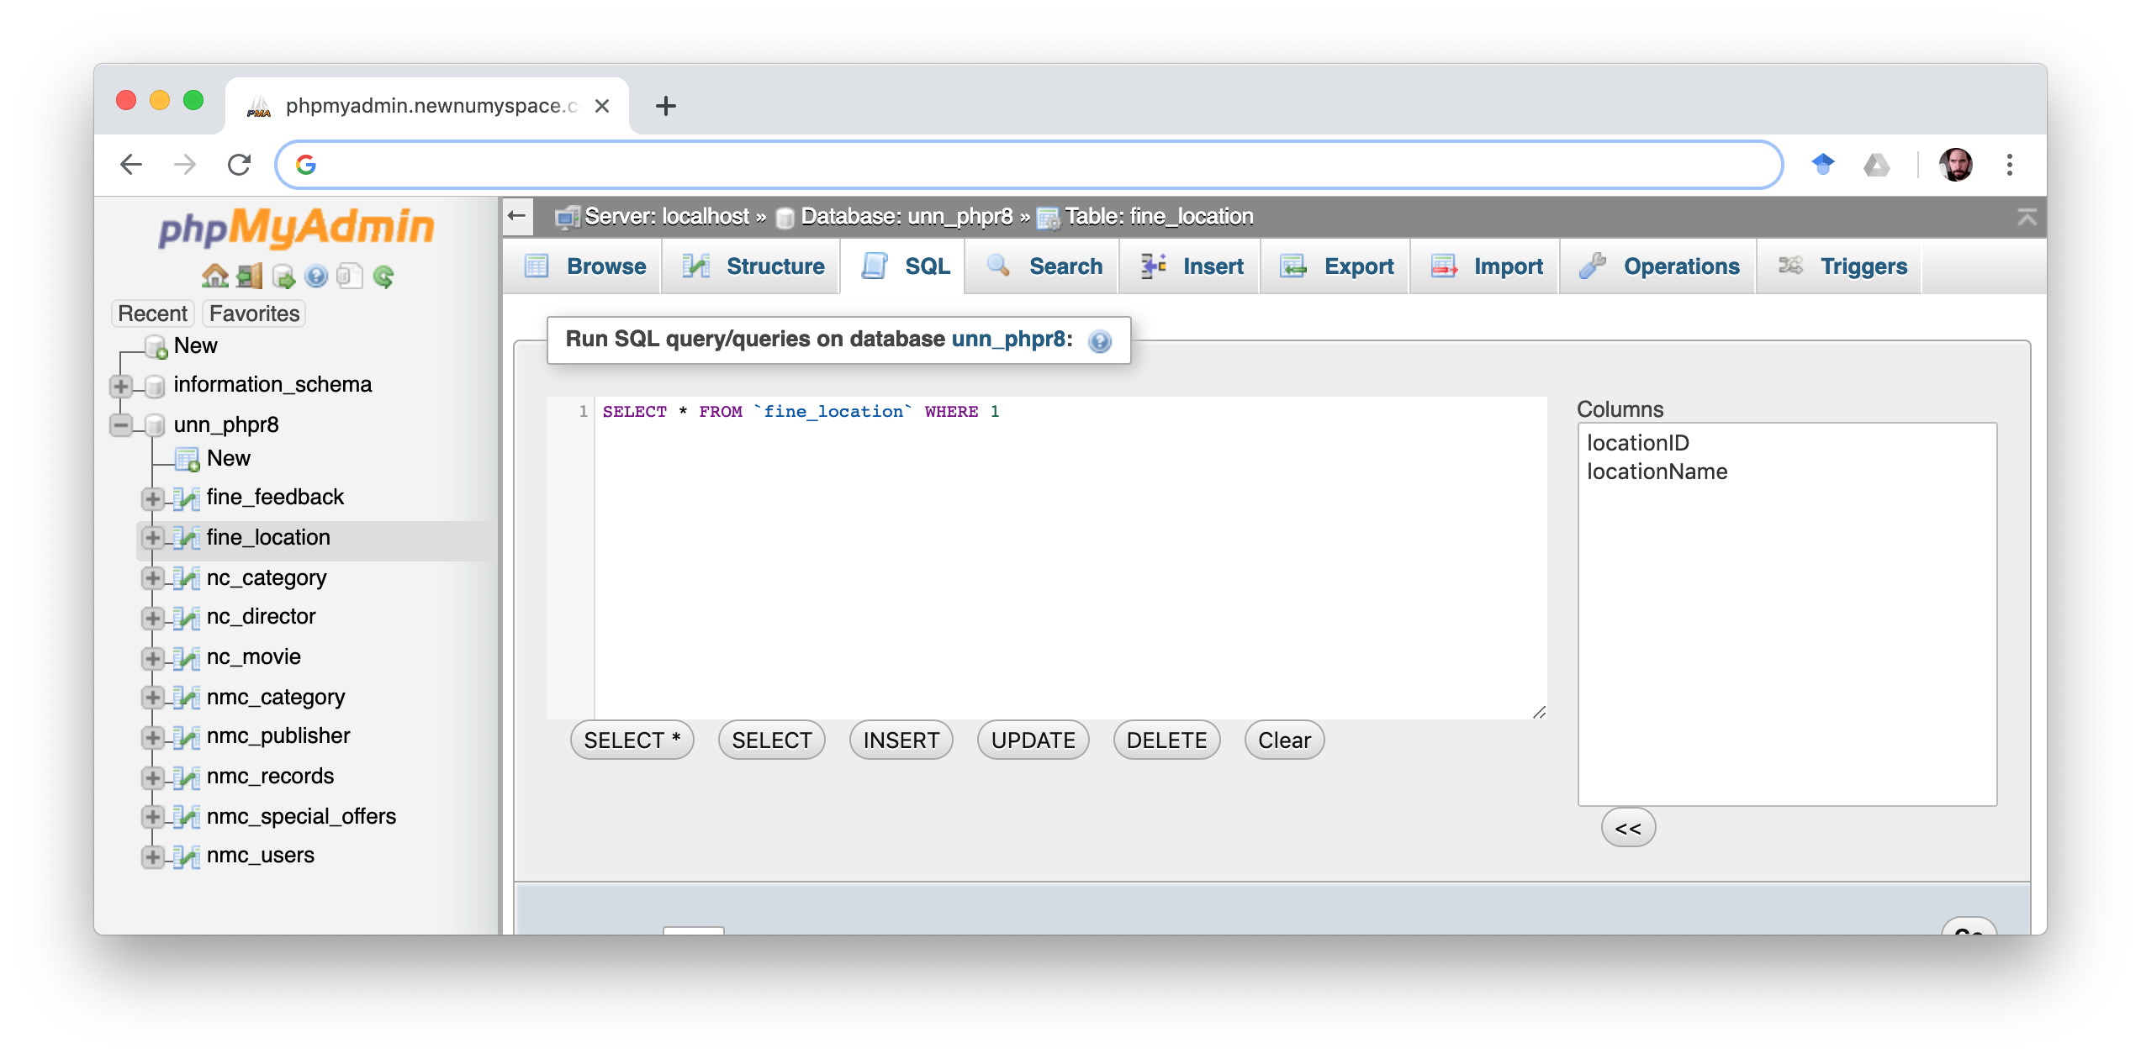
Recap: use phpMyAdmin to test SQL queries

Slide 7
Recap: use phpMyAdmin to test SQL queries

Slide 8
Retrieving data from a database with PHP
With PHP you can connect to many databases including:
MySQL, MongoDB, Oracle, SQLite
PHP offers several different functions for connecting to databases
For connecting to MySQL, there are two main options
MySQLi
“MySQL Improved”
This is a MySQL specific library
PDO
“PHP Data Objects”
This library will work for several databases, including MySQL, Oracle and SQLite
MySQLi and PDO are both good choices. We will use MySQLi on this course.

Slide 9
Retrieving data from a database with PHP
When retrieving data from a database with MySQLi or PDO we follow these steps:
Create connection to the server
Check connection
Construct and execute the query
Check results
Iterate over the results

Slide 10
Step 1: Connect to the server (MySQLi)

Slide 11
Step 1: Connect to the server (MySQLi)
// define our parameters

Slide 12
Step 1: Connect to the server (MySQLi)
// define our parameters
$servername = ”localhost";
$username = ”unn_w12345678";
$password = ”password1234";
$dbname = “unn_w12345678”;

Slide 13
Step 1: Connect to the server (MySQLi)
// define our parameters
$servername = ”localhost";
$username = ”unn_w12345678";
$password = ”password1234";
$dbname = “unn_w12345678”; // Create connection
$conn = new mysqli($servername, $username, $password, $dbname);

Slide 14
Step 1: Connect to the server (MySQLi)
// Create connection with parameters
$conn = new mysqli(”localhost”, “unn_w12345678”, “password1234”, “unn_w12345678”);

Slide 15
Note: object oriented PHP
There different paradigms for writing code (including PHP)
Procedural
Object Oriented
We are mainly using a procedural style on this course
For connecting to databases we are using an object oriented style
Hence “new” ( $conn = new mysqli() )
Hence “->” (see upcoming slides)
You can learn more about object oriented PHP in the third year.

Slide 16
Step 2: Check Connection (MySQLi)

Slide 17
Step 2: Check Connection (MySQLi)
// Check connection

Slide 18
Step 2: Check Connection (MySQLi)
// Check connection
// There are several ways to do this …

Slide 19
Step 2: Check Connection (MySQLi)
// Check connection
// There are several ways to do this … number 1:
if ($conn->connect_error) { die("Connection failed: " . $conn->connect_error); }

Slide 20
Step 2: Check Connection (MySQLi)
// Check connection
// There are several ways to do this … number 2:
if ($conn === false) { echo '<p>sorry the connection failed</p>’;
echo '<p>The error was: ' . $conn->connect_error . '</p>’;
exit;
}

Slide 21
Step 2: Check Connection (MySQLi)
// Check connection
// There are several ways to do this … number 3:
$conn = new mysqli(”localhost”, “unn_phpr8”, “password1234”, “unn_phpr8”)
or die('<p>sorry the connection failed</p>’);

Slide 22
Step 3: Construct and execute the query

Slide 23
Step 3: Construct and execute the query
// construct and execute a query

Slide 24
Step 3: Construct and execute the query
// construct and execute a query
$queryResult = $conn->query();

Slide 25
Step 3: Construct and execute the query
// construct and execute a query
$queryResult = $conn->query(“select … from … “);

Slide 26
Step 3: Construct and execute the query
Table: film
Example queries
filmID | title | category | notes
1 | Frozen | c1
2 | Up | c1
3 | Coco | c1
4 | Star Wars | c2

Slide 27
Step 3: Construct and execute the query
Table: film
Example queries
SELECT * FROM film;
filmID | title | category | notes
1 | Frozen | c1
2 | Up | c1
3 | Coco | c1
4 | Star Wars | c2

Slide 28
Step 3: Construct and execute the query
Table: film
Example queries
SELECT * FROM film;
SELECT title, category FROM film;
filmID | title | category | notes
1 | Frozen | c1
2 | Up | c1
3 | Coco | c1
4 | Star Wars | c2

Slide 29
Step 3: Construct and execute the query
Table: film
Example queries
SELECT * FROM film;
SELECT title, category FROM film;
SELECT category FROM film WHERE title = ‘Frozen’;
filmID | title | category | notes
1 | Frozen | c1
2 | Up | c1
3 | Coco | c1
4 | Star Wars | c2

Slide 30
Step 3: Construct and execute the query
Table: film
Example queries
SELECT * FROM film;
SELECT title, category FROM film;
SELECT category FROM film WHERE title = ‘Frozen’;
Remember - Check your queries in PHPmyAdmin
filmID | title | category | notes
1 | Frozen | c1
2 | Up | c1
3 | Coco | c1
4 | Star Wars | c2

Slide 31
Step 3: Construct and execute the query
// construct and execute a query
$queryResult = $con->query(“select * from film“);

Slide 32
Step 3: Construct and execute the query
// construct query
$my_query = “select * from film“;
// execute a query
$queryResult = $conn->query($my_query);

Slide 33
Step 4: Check the results

Slide 34
Step 4: Check the results
// check if query was successful (Several ways to do this)

Slide 35
Step 4: Check the results
// check if query was successful (Several ways to do this)
If ($queryResult === false) {
echo "<p>Query failed: ” . $conn->error . "</p>";
exit;
}

Slide 36
Step 5: Iterate over the results:

Slide 37
Step 5: Iterate over the results:
// get one row of the results
$row = $queryResult->fetch_object()

Slide 38
Step 5: Iterate over the results:
// iterate over the results
while ($row = $queryResult->fetch_object()) {
//do something
}

Slide 39
Step 5: Iterate over the results:
// iterate over the results
while ($row = $queryResult->fetch_object()) {
echo “<p>Title: “. $row->title . “ Category: “ . $row->category.”</p>;
}

Slide 40
Step 5: Iterate over the results:
// iterate over the results
while ($row = $queryResult->fetch_object()) {
echo “<p>Title: “. $row->title . “ Category: “ . $row->category.”</p>;
}
Title: Frozen Category: c1
Title: Up Category: c1
Title: Coco Category: c1
Title: Star Wars Category: c2

Slide 41
Step 5: Iterate over the results:
// iterate over the results
echo “<table><tr><th>Title</th><th>Category</th></tr>”
While ($row = $queryResult->fetch_object()) {
echo “<tr><td>“. $row->title . “</td><td>“ . $row->category . ”</td></tr>”;
}
echo “</table>
Title Category
Frozen c1
Up c1
Coco c1
Star Wars c2

Slide 42
Joining two database tables
Table: film
Table: category
filmID | title | category | notes
1 | Frozen | c1
2 | Up | c1
3 | Coco | c1
4 | Star Wars | c2
catID | catName
c1 | Animation
c2 | Science Fiction
c3 | Rom Com

Slide 43
Joining two database tables
Table: film
Table: category
filmID | title | category | notes
1 | Frozen | c1
2 | Up | c1
3 | Coco | c1
4 | Star Wars | c2
catID | catName
c1 | Animation
c2 | Science Fiction
c3 | Rom Com
Example query
SELECT title, catName
FROM film
INNER JOIN category ON film_category.catID = film.category

Slide 44
Joining two database tables
// construct query
$my_query = “SELECT title, catName
FROM film
INNER JOIN category ON film_category.catID = film.category";
// execute a query
$queryResult = $conn->query($my_query);
// check if query was successful
…

Slide 45
Joining two database tables
// iterate over the results
echo “<table><tr><th>Title</th><th>Category</th></tr>”
While ($row = $queryResult->fetch_object()) {
echo “<tr><td>“. $row->title . “</td><td>“ . $row->catName . ”</td></tr>”;
}
echo “</table>
Title Category
Frozen Animation
Up Animation
Coco Animation
Star Wars Science Fiction

Slide 46
Put it all together
<?php
$conn = new mysqli(”localhost”, “unn_w12345678”, “password1234”, “unn_w12345678”);
if ($conn === false) {
echo ‘<p>Connection Error: ' . $conn->connect_error . '</p>’;
exit;
}
$my_query = “select title from film“;
$queryResult = $conn->query($my_query);
if ($queryResult === false) {
echo "<p>Query Error: ".$conn->error."</p>”
exit;
while ($row = $queryResult->fetch_object()) {
echo “<p>Title: “. $row->title .”</p>;
}
?>

Slide 47
Put it all together (with ‘include’)
index.php
<?php
include ‘database_connect.php’;
$my_query = “select title from film“;
$queryResult = $conn->query($my_query);
if ($queryResult === false) {
echo "<p>Query Error: ".$conn->error."</p>”
exit;
while ($row = $queryResult->fetch_object()) {
echo “<p>Title: “. $row->title .”</p>;
}
?>

Slide 48
Put it all together (with ‘include’)
index.php
database_connect.php
<?php
include ‘database_connect.php’;
$my_query = “select title from film“;
$queryResult = $conn->query($my_query);
if ($queryResult === false) {
echo "<p>Query Error: ".$conn->error."</p>”
exit;
while ($row = $queryResult->fetch_object()) {
echo “<p>Title: “. $row->title .”</p>;
}
?>
<?php
$conn = new mysqli(”localhost”, “unn_w12345678”, “password1234”, “unn_w12345678”);
if ($conn === false) {
echo ‘<p>Connection Error: ‘ . $conn->connect_error . '</p>’;
exit;
}
?>

Slide 49
Put it all together (with ‘include’)
index.php
<?php
include ‘header.php’;
include ‘database_connect.php’;
$my_query = “select title from film“;
$queryResult = $conn->query($my_query);
if ($queryResult === false) {
echo "<p>Query Error: ".$conn->error."</p>”
exit;
while ($row = $queryResult->fetch_object()) {
echo “<p>Title: “. $row->title .”</p>;
}
include ‘footer.php’
?>

Slide 50
Put it all together (with ‘include’)
index.php
header.php
<?php
include ‘header.php’;
include ‘database_connect.php’;
$my_query = “select title from film“;
$queryResult = $conn->query($my_query);
if ($queryResult === false) {
echo "<p>Query Error: ".$conn->error."</p>”
exit;
while ($row = $queryResult->fetch_object()) {
echo “<p>Title: “. $row->title .”</p>;
}
include ‘footer.php’
?>
<!doctype html>
<html>
<head>
<title>Films</title>
</head>
<body>
<nav>
….
</nav>

Slide 51
Resources
W3C Schools SQL tutorial:
https://www.w3schools.com/sql/default.asp
Khan Academy have a more in depth course on SQL and databases:
https://www.khanacademy.org/computing/computer-programming/sql
MySQL:
https://www.mysql.com/
phpMyAdmin:
https://www.phpmyadmin.net/

